Slide 1


Réunion des Chefs de Service NICU
Diensthoofdenvergadering
Salons de Romree, Grimbergen
26/05/2026
This meeting is supported by

Slide 2

Program
19:00 Welcome drink
19:25 Short presentation by GSK
19:30 Benchmarking NICU data in Belgium; where to go (Gunnar Naulaers)
20:00 eNewborn: European Neonatal Benchmarking & Evaluation Program (Neena Modi – Ricardo Ribas)
21:00 Break
21:15 Update on NICU Nomenclature (Luc Cornette)
21:45 Societal News (Kris De Coen)
          Autumn meeting 2026
          Education by BVN-GBN
          News form the project groups
          RSV-profylaxis 2025-2026
          Website BVN-GBN
          NIC statistics 2025
          …
22:00 Your suggestions
22:30 Closure

Slide 3
GUNNAR NAULAERS
BENCHMARKING NICU DATA IN BELGIUM
WHERE TO GO?

Slide 4
BVN NEONATAL DATABASES
Current Status, Challenges & Future Directions
Presented to: Medical Directors of NICU
Belgische Vereniging voor Neonatologie (BVN)

Slide 5
DATABASE OVERVIEW
Four Active Databases – Belgian Newborn Network
Euroneonet
Nicaudit
Neokiss
Follow-up
42 items
84 items
84 items
1,037 items
Items
Items
Items
Items
2002
2008
2011
2015
Since
Since
Since
Since
>60,000
>60,000
>10,000
>10,000
Records
Records
Records
Records
Outputs
Outputs
Outputs
Outputs
Annual report per center
Online benchmarking
Statistics on demand
Annual report
Online benchmarking
Statistics on demand
Annual report
Online benchmarking
Statistics on demand
Statistics on demand
Yearly RIZIV/INAMI report
Bilans A–D
19 NIC units participating across Belgium
BVN – Neonatal Database Status | Medical Directors Meeting

Slide 6
INFRASTRUCTURE
Current Data Architecture
Data Management
Technology Partners
All data centrally managed by Ba (database administrator)
Ensures data consistency and access control
Neonid (historical provider)
eSOHA (current partner)
Server Infrastructure
GDPR Compliance
Hosted server environment
⚠ Critical issue: see next slide
GDPR-approved program in place
Data protection standards met
BVN – Neonatal Database Status | Medical Directors Meeting

Slide 7
⚠ CRITICAL INFRASTRUCTURE ISSUE
Server Migration — Loss of Operational Access
Root Cause
Current Impact
Acugis server was migrated from UK to USA without notice or coordination with BVN
Complete loss of ability to use the server for all database operations since migration
Communication
Continuity Risk
Multiple emails sent; responses limited to 'we will look at it' — no resolution timeline provided
Operational sustainability is uncertain; long-term server availability cannot be guaranteed
Data Recovery
Backup Status
Data extracted from Oracle DB; transfer to .xlm format is currently in progress by Ba
Data through end of 2024 confirmed safe. Recovery of 2025–2026 data is underway by Ba
BVN – Neonatal Database Status | Medical Directors Meeting

Slide 8
DECISION REQUIRED
Server Migration — Three Candidate Solutions
The current situation is not sustainable. A decision on a new hosting solution is required.
Option 1
Option 2
Option 3
Sciensano
University Hospital Server
Enewborn UK
Advantages
Advantages
Advantages
National public health institute — Belgium
Established data governance framework
Potential alignment with national health data policy
Academic, GDPR-compliant environment
Proximity to neonatal research community
Potential for data linkage with clinical systems
Purpose-built neonatal data platform
Established track record in neonatal networks
Potential for international benchmarking
Considerations
Considerations
Considerations
Governance and access model to be negotiated
Onboarding timeline unknown
Institution-specific governance constraints
Hosting agreements need formal establishment
Contractual and cost model to be clarified
BVN – Neonatal Database Status | Medical Directors Meeting

Slide 9
GOVERNANCE
New Supervision Structure for the Database
Colleges will no longer be supported. A dedicated Supervision Committee will replace them to ensure ongoing oversight.
BVN Representatives
Follow-Up Centers
Government / FOD
Database Management
RIZIV / INAMI
Kris De Coen
1–2 representatives from participating centers
Kelly Jansen (FOD)
Nele De Bruyn (Database Manager)
Representative from RIZIV Akkoordraad
Liesbeth Thewissen
(to be confirmed)
(to be confirmed)
Inge Vanherreweghe
First committee meeting underway with BVN and key stakeholders
BVN – Neonatal Database Status | Medical Directors Meeting

Slide 10
FINANCES
Current Database Funding (FOD B4 Contract)
€55,000
€21,000
€34,000
Database Manager – Follow-Up
IT Management
Annual FOD allocation
(B4 contract)
Nele De Bruyn, UGent
Technical infrastructure & operations
· 3 meetings with follow-up centers/year
· Server hosting & maintenance
· Yearly RIZIV-INAMI follow-up report
· Data management & security
· Database supervision
· Application support
Funding Outlook
✓ 2026: Confirmed ~ 2027: Likely (high confidence) 2028+: No guarantee — continuity planning required
BVN – Neonatal Database Status | Medical Directors Meeting

Slide 11
FUTURE PROJECTS
Governance & Reporting
A. NICaudit
Supervision Committee
Annual Report NICaudit
Finalise the formal work tasks of the Supervision Committee
Define and confirm individual roles for each committee member
Schedule inaugural committee meeting
Evaluate feasibility and cadence of a yearly NICaudit report
Define scope, format, and distribution of the annual report
Align reporting timeline with FOD and RIZIV/INAMI obligations
B. Follow-Up
RIZIV/INAMI Annual Report
Data Linkage with NICaudit
Deliver the yearly follow-up report as required under the B4 contract; consolidate findings for the RIZIV Akkoordraad
Develop methodology to cross-reference Follow-Up outcomes with NICaudit registry data to enrich longitudinal analyses
BVN – Neonatal Database Status | Medical Directors Meeting

Slide 12
FUTURE PROJECTS
Extension of Follow-Up & New Clinical Cohorts
Follow-Up Extension to Age 8
New questionnaire development — adapted for age 8 assessment
Selection criteria for clinical follow-up cohort
Contact: Nele De Bruyn (database coordination) · Renaud Villevoye (clinical coordination)
Clinical Cohorts — New Registry Protocols
HIE with Therapeutic Cooling
Symptomatic Congenital CMV
Brain Lesions (>32 weeks GA)
Cardiac Surgery Patients
Structured data capture for neonates with hypoxic-ischaemic encephalopathy undergoing cooling therapy
Follow-up protocol for neonates with confirmed symptomatic congenital cytomegalovirus infection
Registry for neonates born beyond 32 weeks with documented brain lesions on neuroimaging
Neurodevelopmental and clinical follow-up for neonates who underwent cardiac surgery
Working groups are currently being formed — contact Nele De Bruyn or Renaud Villevoye to participate
BVN – Neonatal Database Status | Medical Directors Meeting

Slide 13
Key Actions Required
1
Decide on new server hosting solution
(Sciensano / University Hospital / Enewborn UK)
2
Confirm composition of the new Supervision Committee
and schedule inaugural meeting
3
Ensure data backup completion for 2025–2026
and validate migrated data integrity
4
Initiate long-term funding planning beyond 2027
and engage FOD for continuity
Belgische Vereniging voor Neonatologie (BVN)

Slide 14
NEENA MODI – RICARDO RIBAS eNEWBORN
EUROPEAN NEONATAL BENCHMARKING & EVALUATION PROGRAM
Please don’t discuss “on the side”
Let’s give each other space to ask questions
https://www.imperial.ac.uk/neonatal-data-analysis-unit/enewborn/

Slide 15
LUC CORNETTE
NICU NOMENCLATURE
UPDATE

Slide 16
KRIS DE COEN
SOCIETAL NEWS
BVN-GBN @ your service

Slide 17
Autumn meeting
08/10/2026 Salons the Romrée, Grimbergen
“N.AI.CU: AI within the NICU”
Does AI help in Clinical Neonatal Practice? E. Rotunno (CHU St-Pierre)
How to interact with AI C. Desmedt (KU Leuven)
Management assisted by AI? Y. Austen (Université de Liège)
Ethics and the use of AI F. Devaux
Let us know if you have new staff members to become part of BVN-GBN
Send us your “case of the year” to be presented by a young apprentice 🙏🏻
Notes:
Vertel ik er al iets over van de 20ste editie??

Slide 18


Prix Social Chiesi pour la Néonatologie
Chiesi Sociale Prijs voor Neonatologie
6th edition
€10.000
Please send us your proposals before 04 september 2026

Slide 19
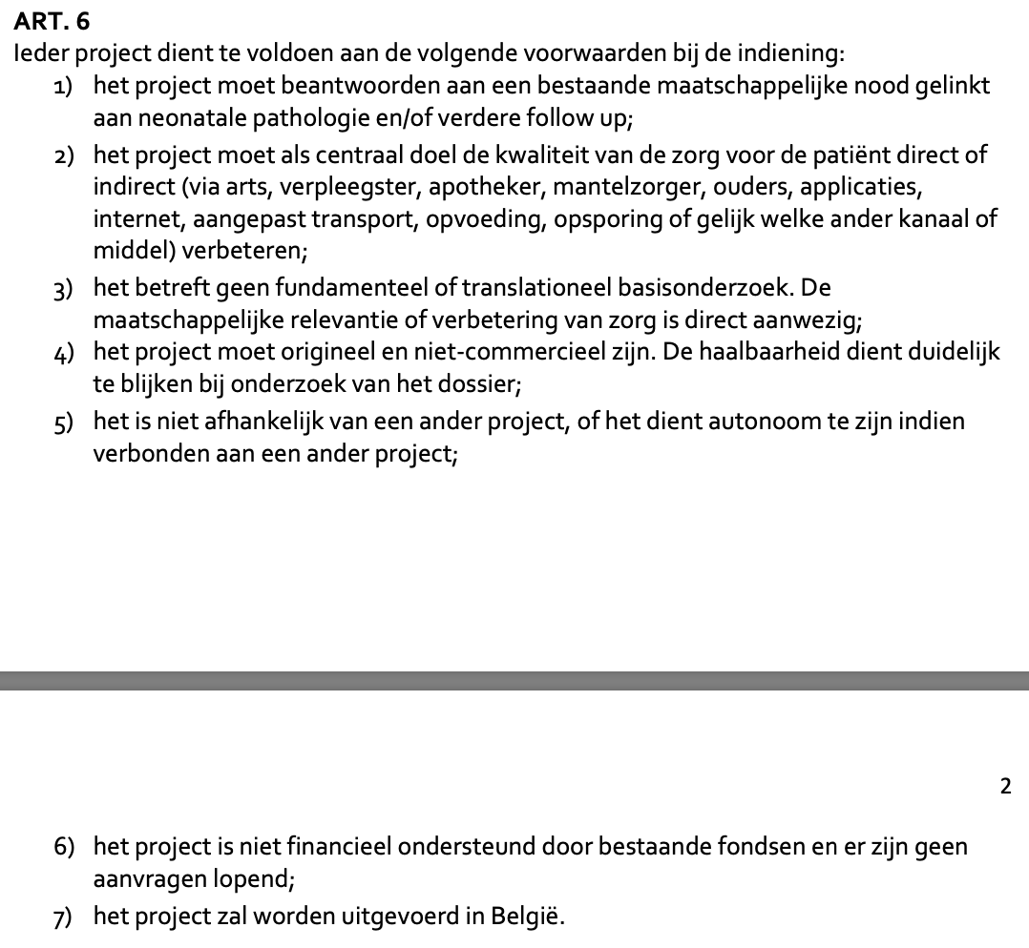
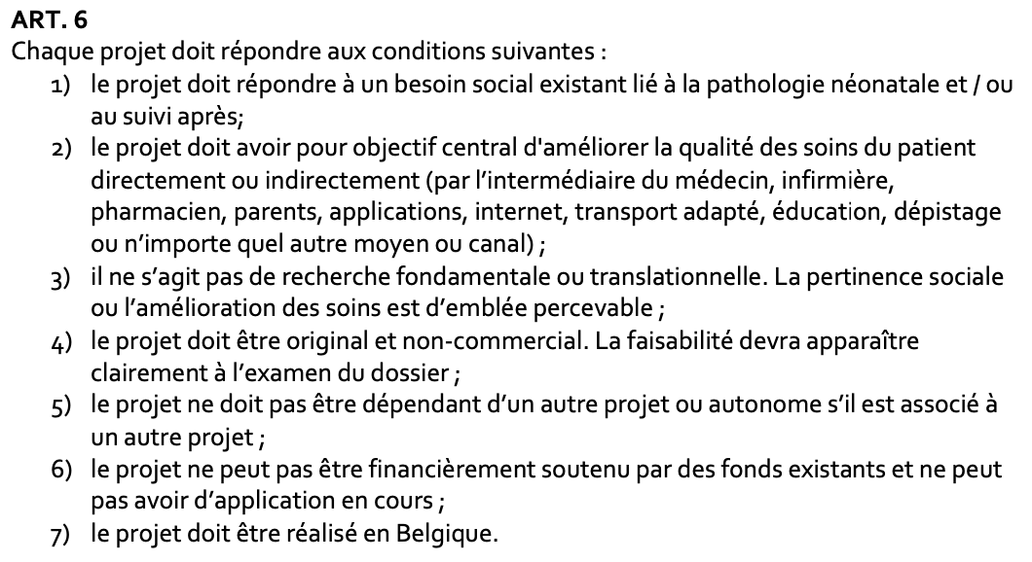


Voorwaarden-Conditions
1 project per NICU
2 jaar “rust” indien winnaar
Een project opnieuw indienen is toegestaan
1 projet par USIN
2 ans de “repos” si lauréat
Vous pouvez resoumettre un projet

Slide 20


Education projects
First Neodays Belgium on 6-7th of February 2026 was successful!
  To be organised biennual 2028
Vascular access will be organised biennual with NEVAT
  March 2027 in Belgium (in English to include FR-speaking colleagues)
POCUS course also organised every 2 year by BVN-GBN
  May-March 2028

Slide 21


Neonatal POCUS in Belgium ?
Indien interesse om mee te werken aan organisatie van training van bedside echografie
Si vous souhaitez contribuer à l'organisation de la formation dans le domaine de l'échographie au chevet du patient
CONTACT : BARBARA.DEBISSCHOP@ZAS.BE
https://beusbelgium.org
https://www.bepocus.org

Slide 22
WERKGROEPEN-GROUPES DE TRAVAIL

Slide 23
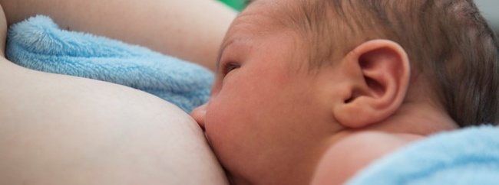


Breastfeeding and human milk banks in the Belgian NICUs
Feedback meeting has been held with all participating centres end of April 2026
EVERYTHING IS GOING VERY WELL
Centres have been asked to have contracts with both banks
UZ Leuven
An Eerdekens
016/347673
Melkbank.doneo@uzleuven.be
Citadelle Liège
Virginie De Halleux
04/3217351
banquedelait@citadelle.be

Slide 24
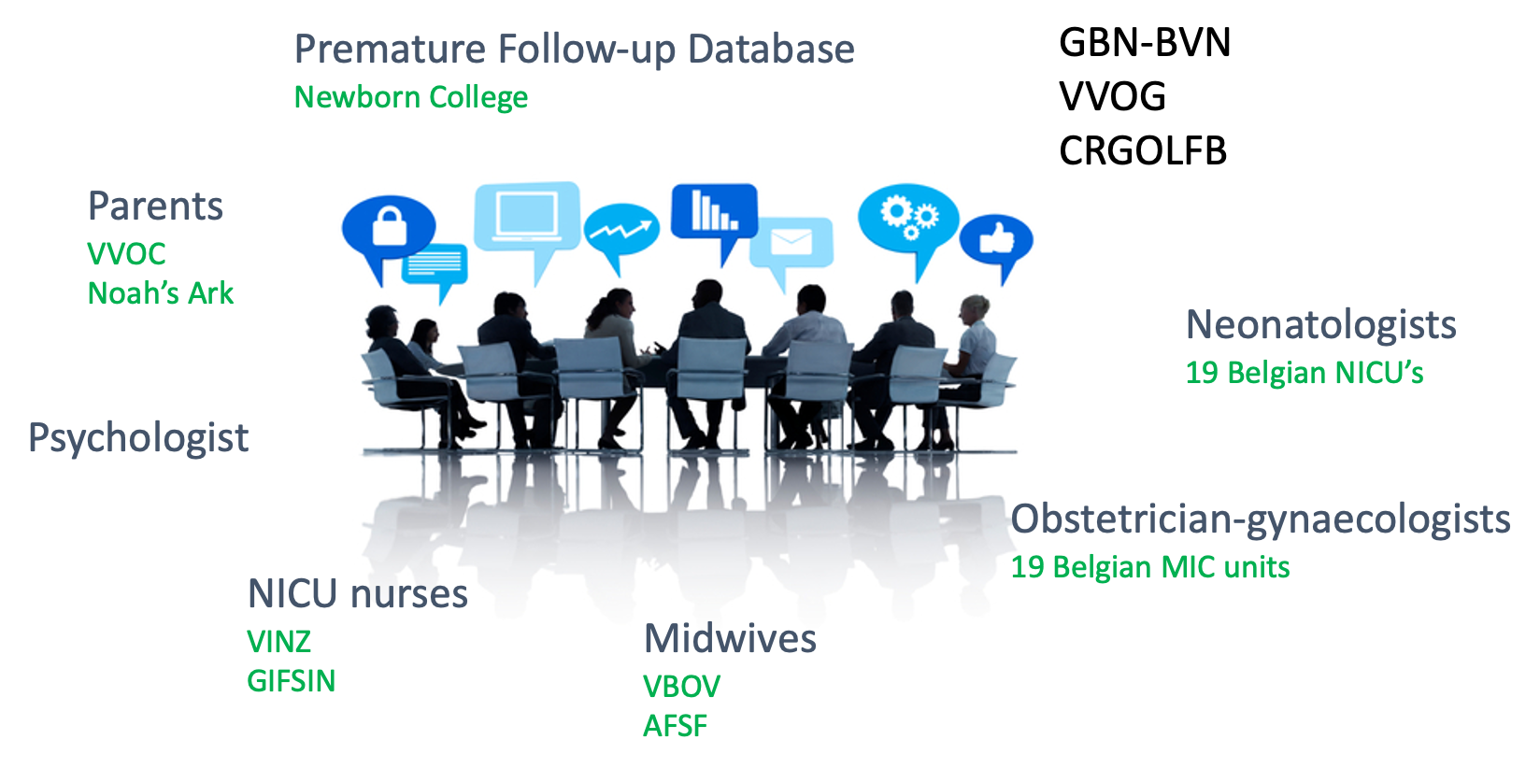
Belgian Consensus Group on the Management of Birth at the Limits of Viability
Filip Cools project coordinator
Launched May 13th, 2024

Slide 25

Work packages
WP1
National survey in HCP’s
WP4
Belgian long-term FU data
WP2
Analysis of recent guidelines
WP5
Parents’ view and preferences
WP3
Search for new studies
WP6
Prenatal counseling
Data from survey are being studied
Recommendations for
clinical care
Recommendations for
prenatal counseling

Slide 26
Reimbursement rooming in for parents and psychological support
SUPPAR-GRIP
Pierre Maton | CHC Monlégia
Katleen Plaskie | ZAS
Marie-Rose Van Hoestenberghe | ZOL
Gunnar Naulaers | UZ Leuven
Anne Debeer | UZ Leuven
Donatienne Lagae | CHIREC
Dorottya Kelen | HUDERF
Virginie de Halleux | Citadelle
Sabrina Laroche | UZA
Kris De Coen | UZG
Antoine Bachy | GHdC
Dominique Grossman | CHIREC
Waiting for official reply on formal letter to the Minister of Health
Survey has been sent out to NICU’s
  16/19 have responded
  Large variation in practices
  1 FTE psychologist for each 15 beds
    0,2 to 2,5 FTE in responding NICU’s
Kelly Janssens | FOD
Michel Collart | Noah’s Ark
Kirsten Livens | VVOC
Donatienne Lagae | CHIREC
Dorottya Kelen | HUDERF
Virginie de Halleux | Citadelle
Sabrina Laroche | UZA
Kris De Coen | UZG
Antoine Bachy | GHdC
Dominique Grossman | CHIREC

Slide 27

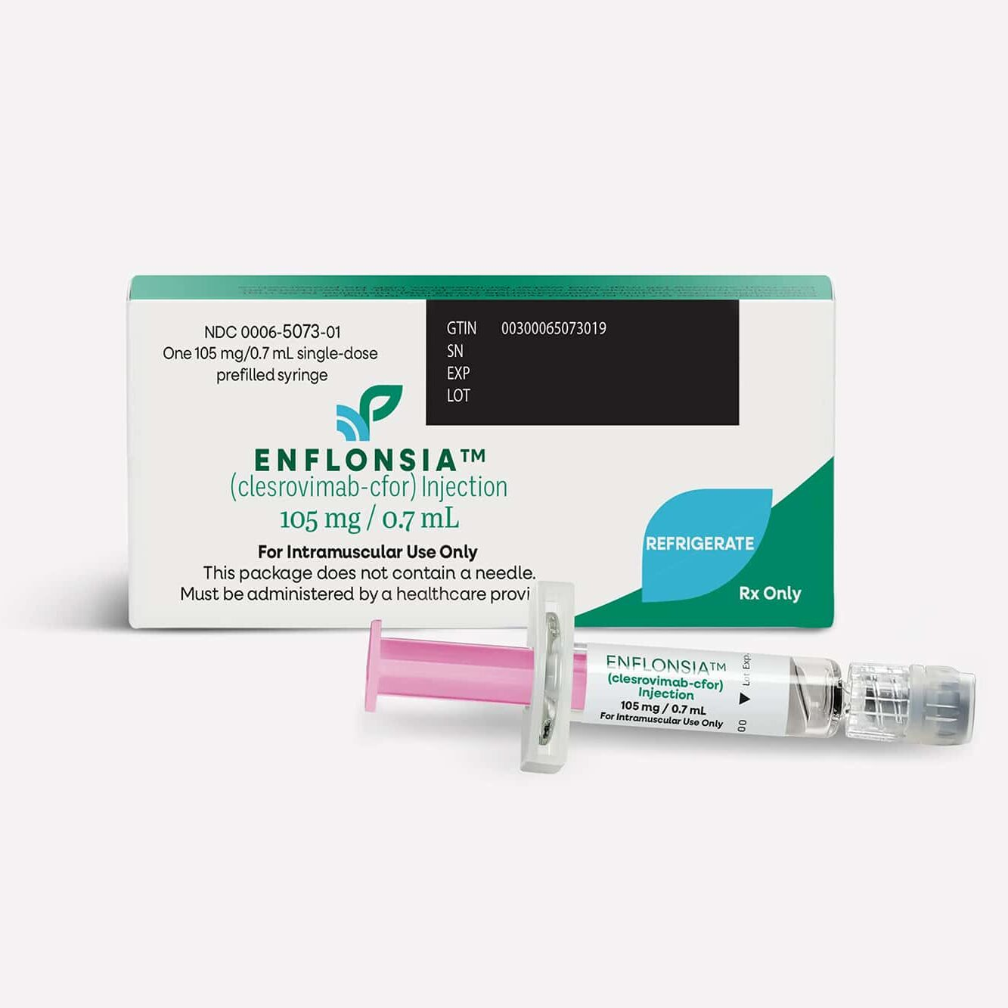

RSV-immunisation Beyfortus®-nirsevimab
A. Lajot, I. Van Evercooren, Y. Lafort, M. Vandromme, L. Cornelissen, K. Blot, S. Hanoteaux, Y. Dockx, S. Denayer, P. Mpakaniye, T. Braeye, BELSARINET research group, M. Urbina, M. Fonnesu, Y. Dupont, L. De Mot. Scientific report. Brussel, België: Sciensano ; 2025. Rapportnummer: D/2025.14.440/90. available on: https://doi.org/10.25608/9tq9-rv90
What is to be expected for the next season 2026-2027?
End of season : 15/03/2026
Beginning of season : 01/10/2026
Significantly less RSV infections in infants <6 months
If hospitalized, mostly infants not immunised
Immunisation effectiveness ± 85%
Coverage rate 62-74%
More news to follow by august 2026…
Probably continuing the current process
Clesrovimab-cfor as alternative ?? …. probably not yet

Slide 28



Website BVN-GBN https://bvn-gbn.be
Website operational since November 2024
Announcement of
  congresses/symposia
  Vacancies for Neonatologists
  News about RSV – Chiesi - …
Membership renewal (85/140 payed – 60/140 site-registered)
NEW Link page to international societies!!

Slide 29
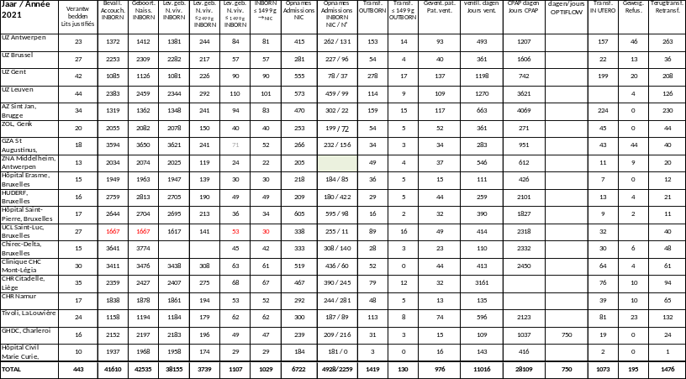
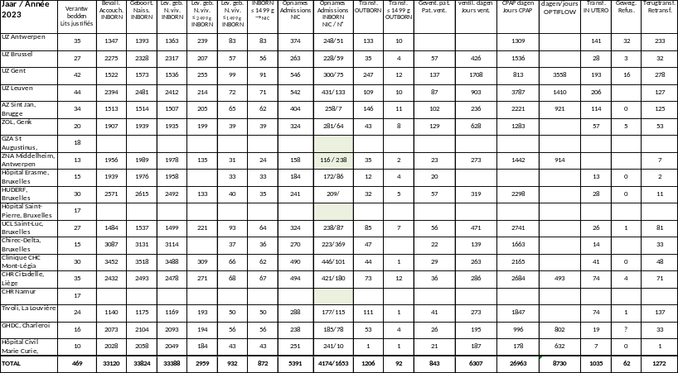
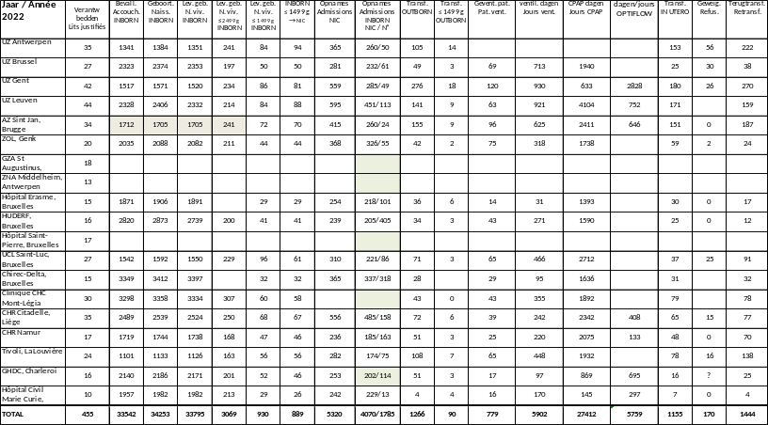
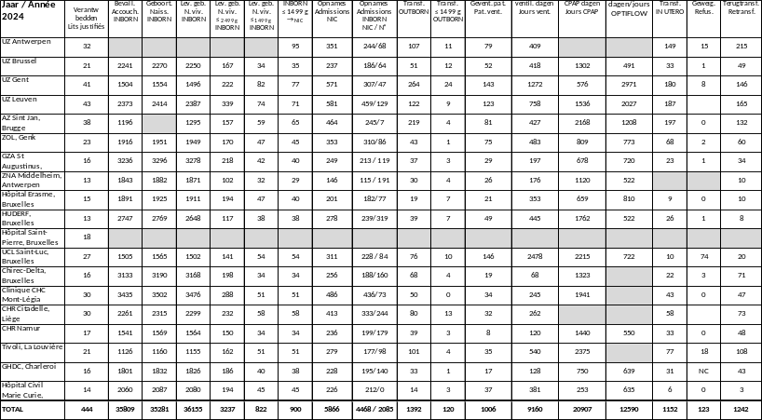
NIC statistics …. Update 2024
2021
2023
1
7
For 2024 responses for
18 out of 19 NICU’s
13/18 with data on Optiflow
2022
7
2024
13

Slide 30
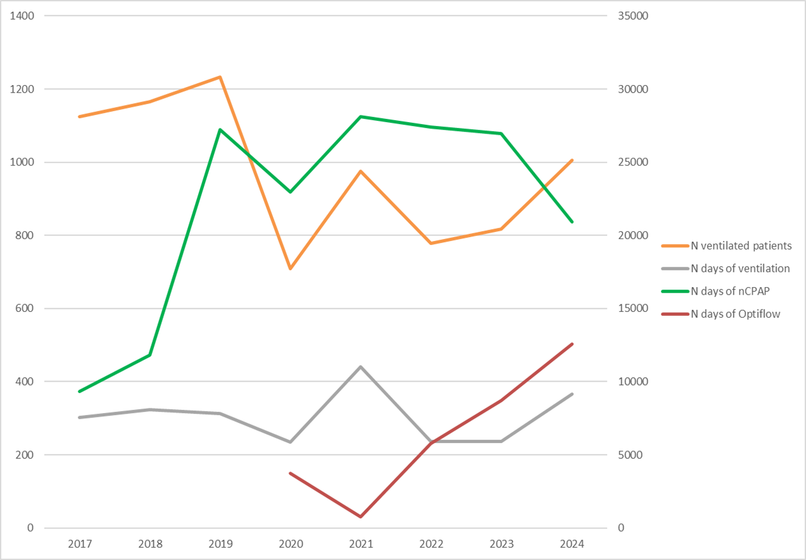
NIC statistics …. updated graph
In 2024
±1000 ventilated pts
± 9000 days ventilation
± 21000 days nCPAP
High flow nasale canula?
6
7
15
14
17
15
15
16
nCPAP reporting NIC
17
18
18
14
19
15
14
18
ventilation reporting NIC

Slide 31
NIC statistics 2025 10/19 received
We welcome your data
hoping to distribute them by our next autumn meeting
≥ 3 lit/min

Slide 32

Is anyone interested in participating @ Societies Forum? Free registration
  Let me know before 15/06/2026
Elections for Executive board of EAPM
  Is anyone of you/your team interested?
  Apply before 06/09/2026
  Please let us know so we can endorse you

Slide 33
Program
19:00 Welcome drink
19:25 Short presentation by GSK
19:30 Benchmarking NICU data in Belgium; where to go (Gunnar Naulaers)
20:00 eNewborn: European Neonatal Benchmarking & Evaluation Program (Neena Modi – Ricardo Ribas)
21:00 Break
21:15 Update on NICU Nomenclature (Luc Cornette)
21:45 Societal News (Kris De Coen)
          Autumn meeting 2026
          Education by BVN-GBN
          News form the project groups
          RSV-profylaxis 2025-2026
          Website BVN-GBN
          NIC statistics 2025
          …
22:00 Your suggestions
22:30 Closure

Slide 34
Important things to remember
Cases of the year for Autumn meeting on 08/10/26 before 04/09/26
Projects for Chiesi Social Prize for Neonatology before 04/09/26
NIC statistics 2025 as soon as possible please
Interest in EAPM ticket our executive board function?
Register @ our website

